Slide 1
SuccessBound
Ohio Department of Higher Education Workforce Initiatives

Slide 2
Higher Education Workforce Initiatives
OhioMeansJobs – Workforce Data Tools
Workforce Development Revolving Loan Program
Regionally Aligned Priorities in Delivering Skills (RAPIDS)
Apprenticeships
Industry- and Sector-based Strategies
Career Development/Student Success
Ohio Means Internships and Co-ops (OMIC)

Slide 3
OhioMeansJobs – Workforce Data Tool
Historical and projected information on graduates in high demand fields
Projections on the demand for jobs today and tomorrow
Identify potential earnings
Identify the number of skilled workers available
Contact information for institutions
Workforce Data Tools - https://workforcedatatools.chrr.ohio-state.edu/home

Slide 4
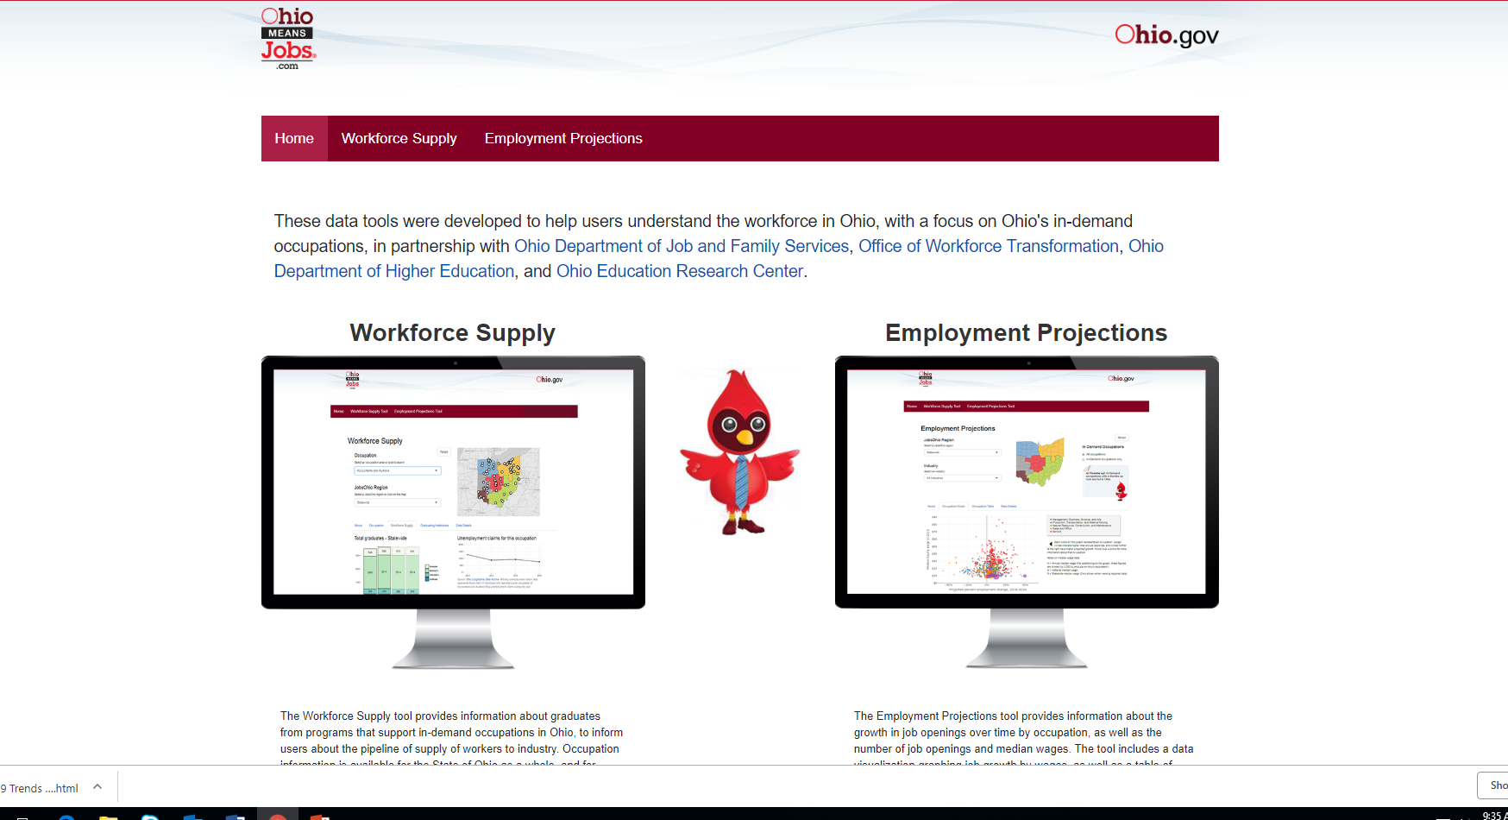
Workforce Data Tools

Slide 5
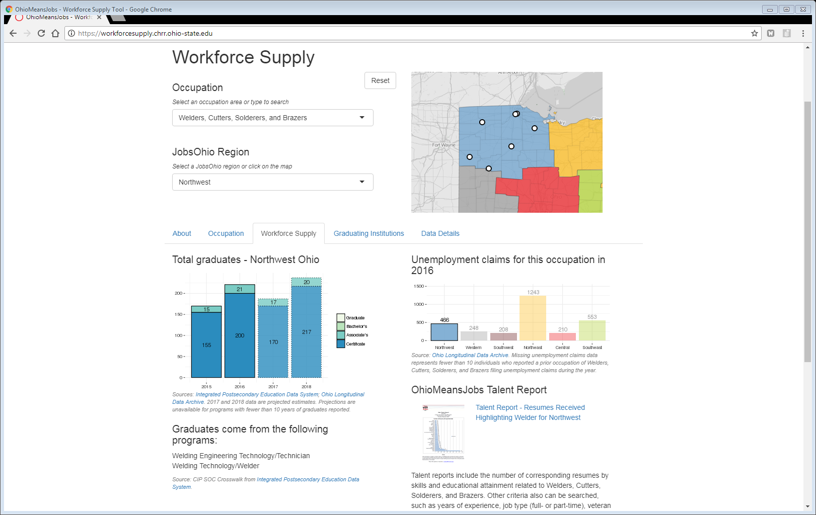
Notes:
Workforce Supply tab shows regional total of recent graduates or certificate completers, as well as projections into the near future. Programs include those in the categories of welding engineering technology and welding technology.
In addition, regional unemployment claims for the occupation are provided; 466 individuals filed unemployment claims in Northwest Ohio in 2016.
Where available, a link to an OMJ report of the number of resumes submitted for this occupation is included.

Slide 6
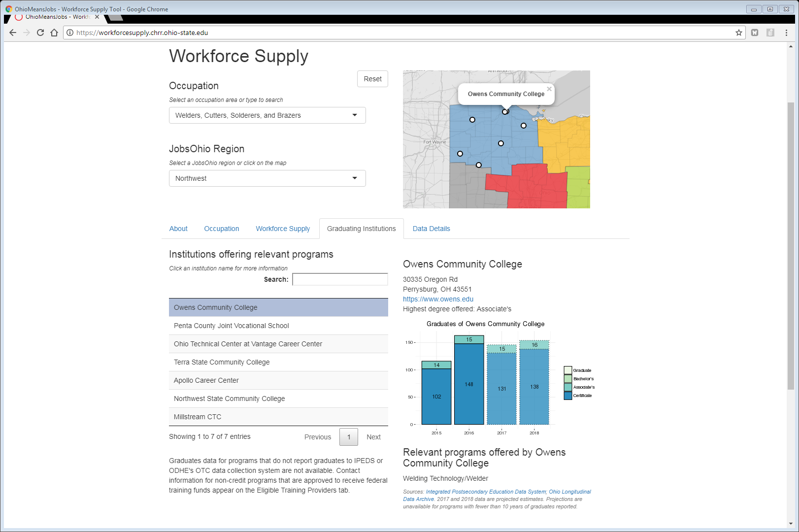
Notes:
The Graduating Institution tab includes a list of postsecondary institutions offering related programs.
Here we selected Owens Community College.
OCC is highlighted on the map above,
A graph of yearly graduates and certificate completers appears to the right, along with near-term graduation projections, and
Address and web address information is provided for more information.

Slide 7
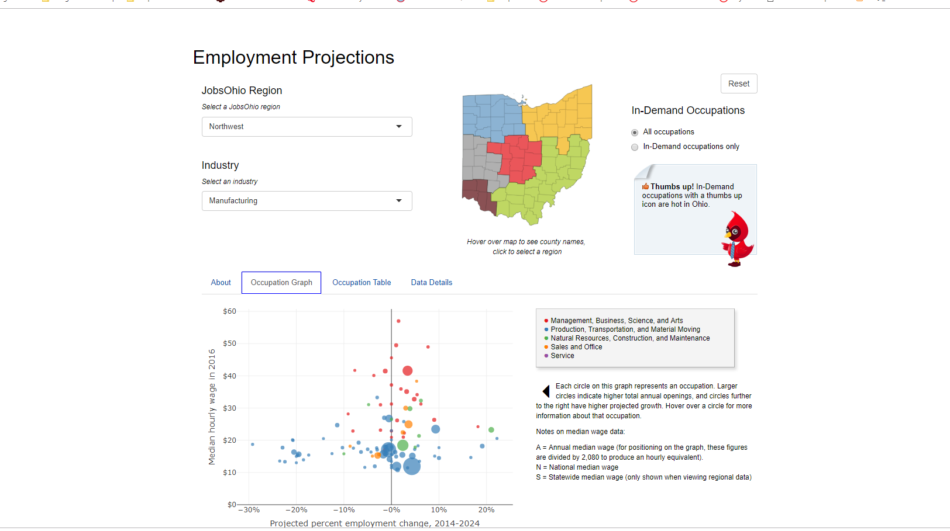
Employment Projections

Slide 8
Workforce Revolving Loan Fund
The purpose of the program is to promote and encourage Ohio’s workforce development and job growth through educational training in programs related to employment opportunities in growing fields.

Slide 9
Workforce Loan Success
40 active grants
81 funded programs
Over 1,000 loans

Slide 10
Program Structure
Jointly administered by OHDE and Treasurer of State (TOS)
  Marketing
  Monitoring
ODHE
  Application review and approval
TOS
  Grant agreements
  Loan approval
  Loan disbursement
  Loan servicing

Slide 11
Workforce Development RLF process
ODHE
Application submitted
ODHE & TOS
Award letter
TOS
Loan approvals
Loan servicing
Revised
Recommended
Grant agreement
Loan disbursements

Slide 12
Workforce RLF
Elements
  $250,000 per program
    Initial award approximately $100,000
  $10,000 - maximum loan per student
Three programs
$500,000 maximum funding at one time

Slide 13
Workforce Loan Application
Keys
  Documented business support
    Need to hire and willingness to interview
  Tuition reimbursement encouraged
    CDL – student stays with a company receives assistance
  Institutional commitment

Slide 14
Recruiting
How will your institution find students?
  Marketing
    Geography
    Strategies
  References
  ODJFS partnerships
  Veterans

Slide 15
Loan Counseling
Specific to the Workforce program
Highlight repayment terms
Perils of non-payment
Loan counseling examples available
Review at the beginning and end of program

Slide 16
Loan Structuring Strategy
Down payments by students
Varied loan amounts depending on need
Revolving loan in combination with other funds
Average loan $5,000
No credit check

Slide 17
Occupational Data
Demonstrated regional need
  OhioMeansJobs and Labor Market Indicator data
  http://ohiolmi.com/proj/OhioJobOutlook.htm
  http://omj.ohio.gov/OMJResources/WorkforcePros.stm
  https://workforcedatatools.chrr.ohio-state.edu/

Slide 18
Workforce Development Loan Administration
Treasurer of State and Value Recovery Group
  Support students during repayment
  Contact students when behind
Institutional support and assistance critical

Slide 19
Informational call
Informational call every Third Monday of the month at 2:15 PM.
  Please register for Ohio Means Jobs Workforce Development Loan Program Informational Webinar on Mar 18, 2019 2:15 PM EDT at:
  https://attendee.gotowebinar.com/register/50209595432541443
  After registering, you will receive a confirmation email containing information about joining the webinar

Slide 20
THANK YOU
John Magill
Assistant Deputy Chancellor, Economic Advancement
614-752-9530
jmagill@highered.ohio.gov
Ohio Treasurer of State
Kerissa Jenkins
Workforce Development Officer
Phone: (614) 728-4843
Kerissa.Jenkins@tos.ohio.gov

Slide 21
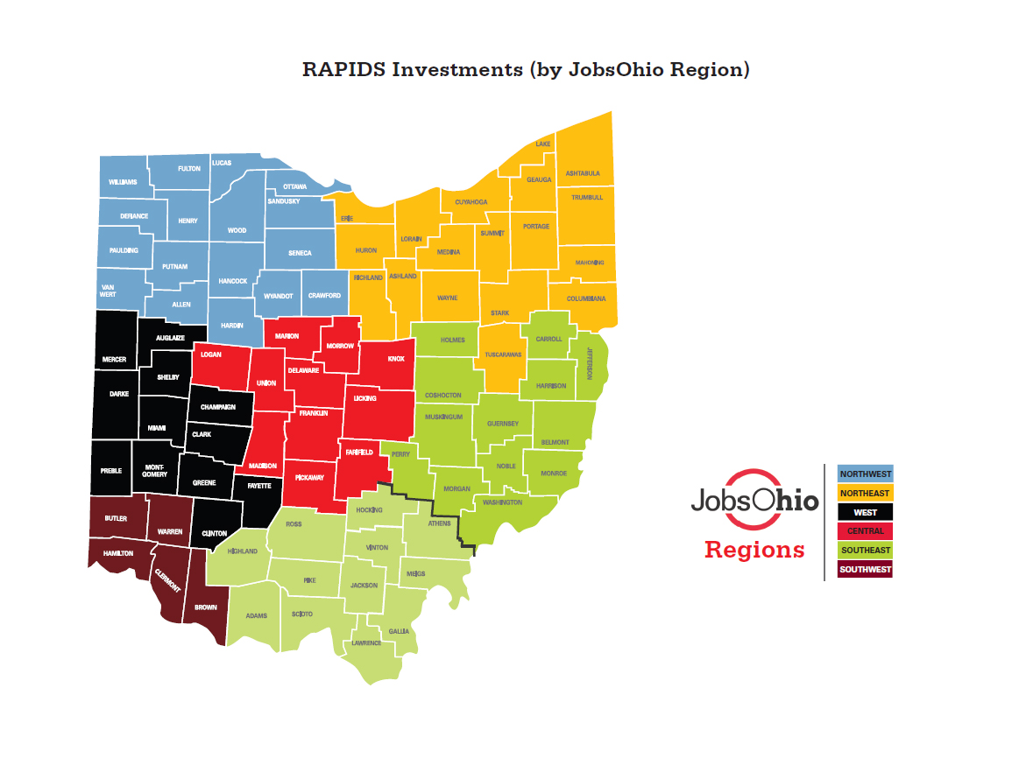

Slide 22
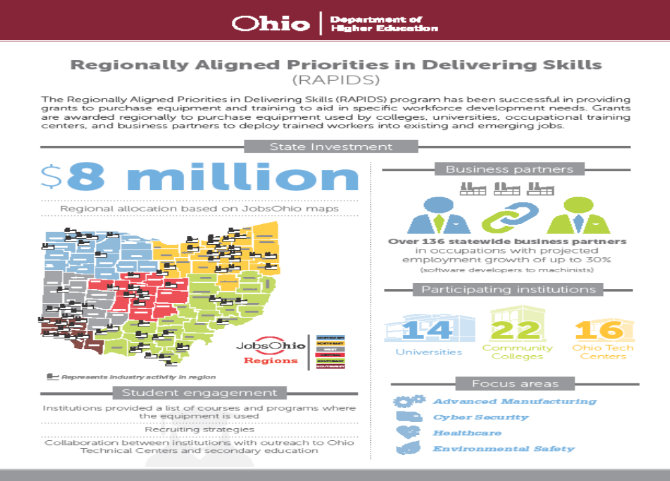

Slide 23
2018 Regional Investments
Region | Targeted Industries
Northeast Ohio-East | Advanced Manufacturing
Northeast Ohio – Central | Advanced Manufacturing/IT/Healthcare
Northeast Ohio – West | Advanced Manufacturing/Healthcare
Northwest Ohio | Advanced Manufacturing/IT
West Ohio | IT
Southwest Ohio | IT/Smart Building
Central Ohio | Healthcare/Information Technology Advanced Manufacturing
Southeast Ohio-South | IT/Healthcare/Advanced Manufacturing
Southeast Ohio – North | Healthcare/Advanced Manufacturing

Slide 24

2018 RAPIDS 4
Regional focus
Institutional collaboration
  Public and non-profit colleges and universities
  Ohio Technical Centers
Allocation per region
Strong business support
Equipment for education and training for in-demand occupations

Slide 25
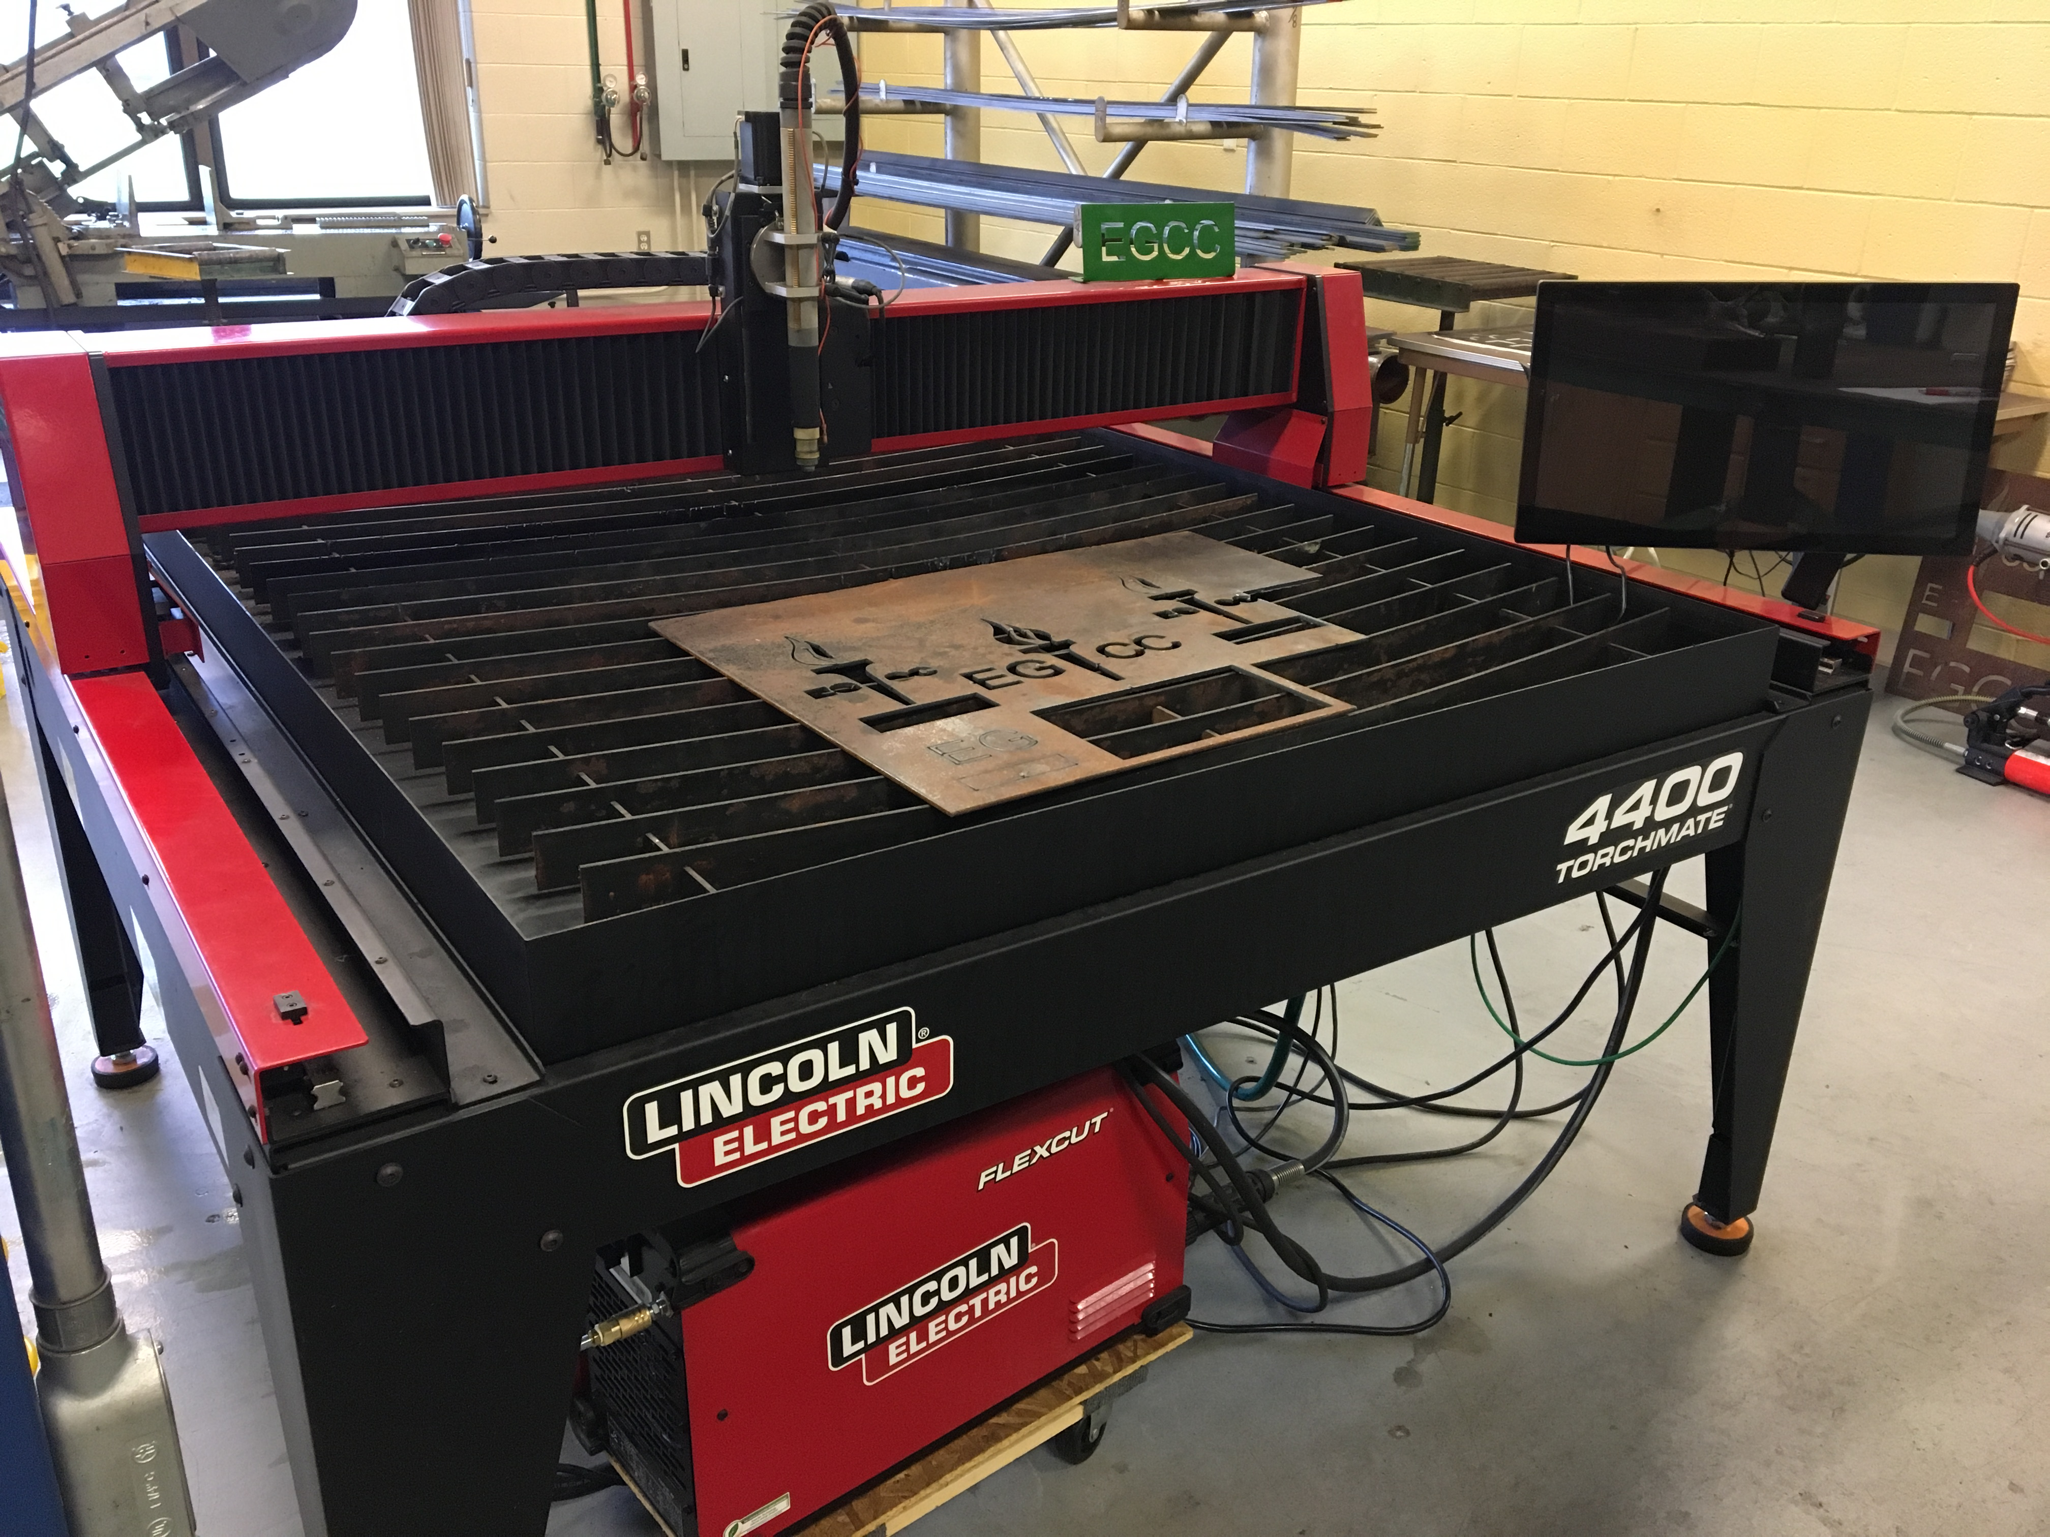
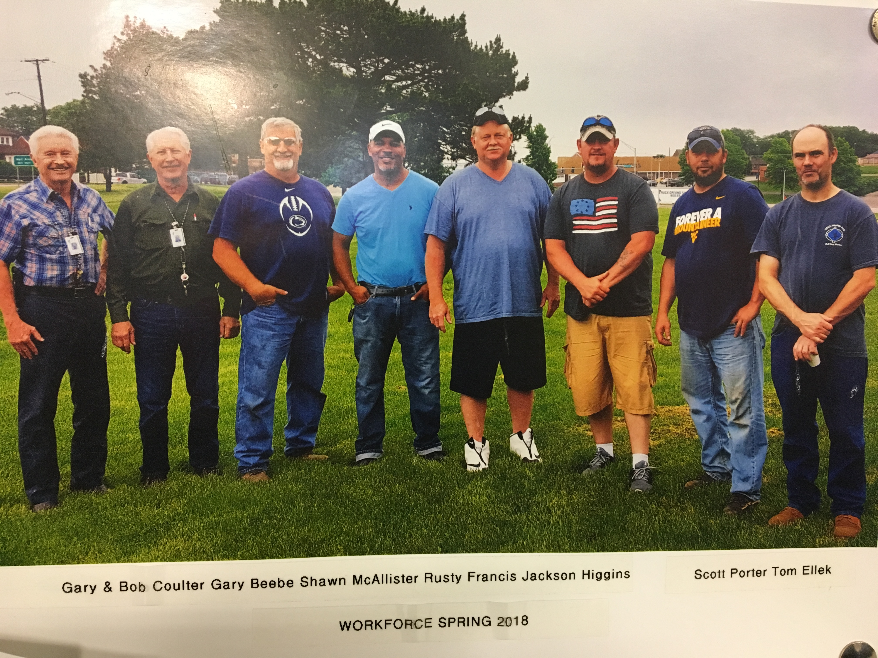
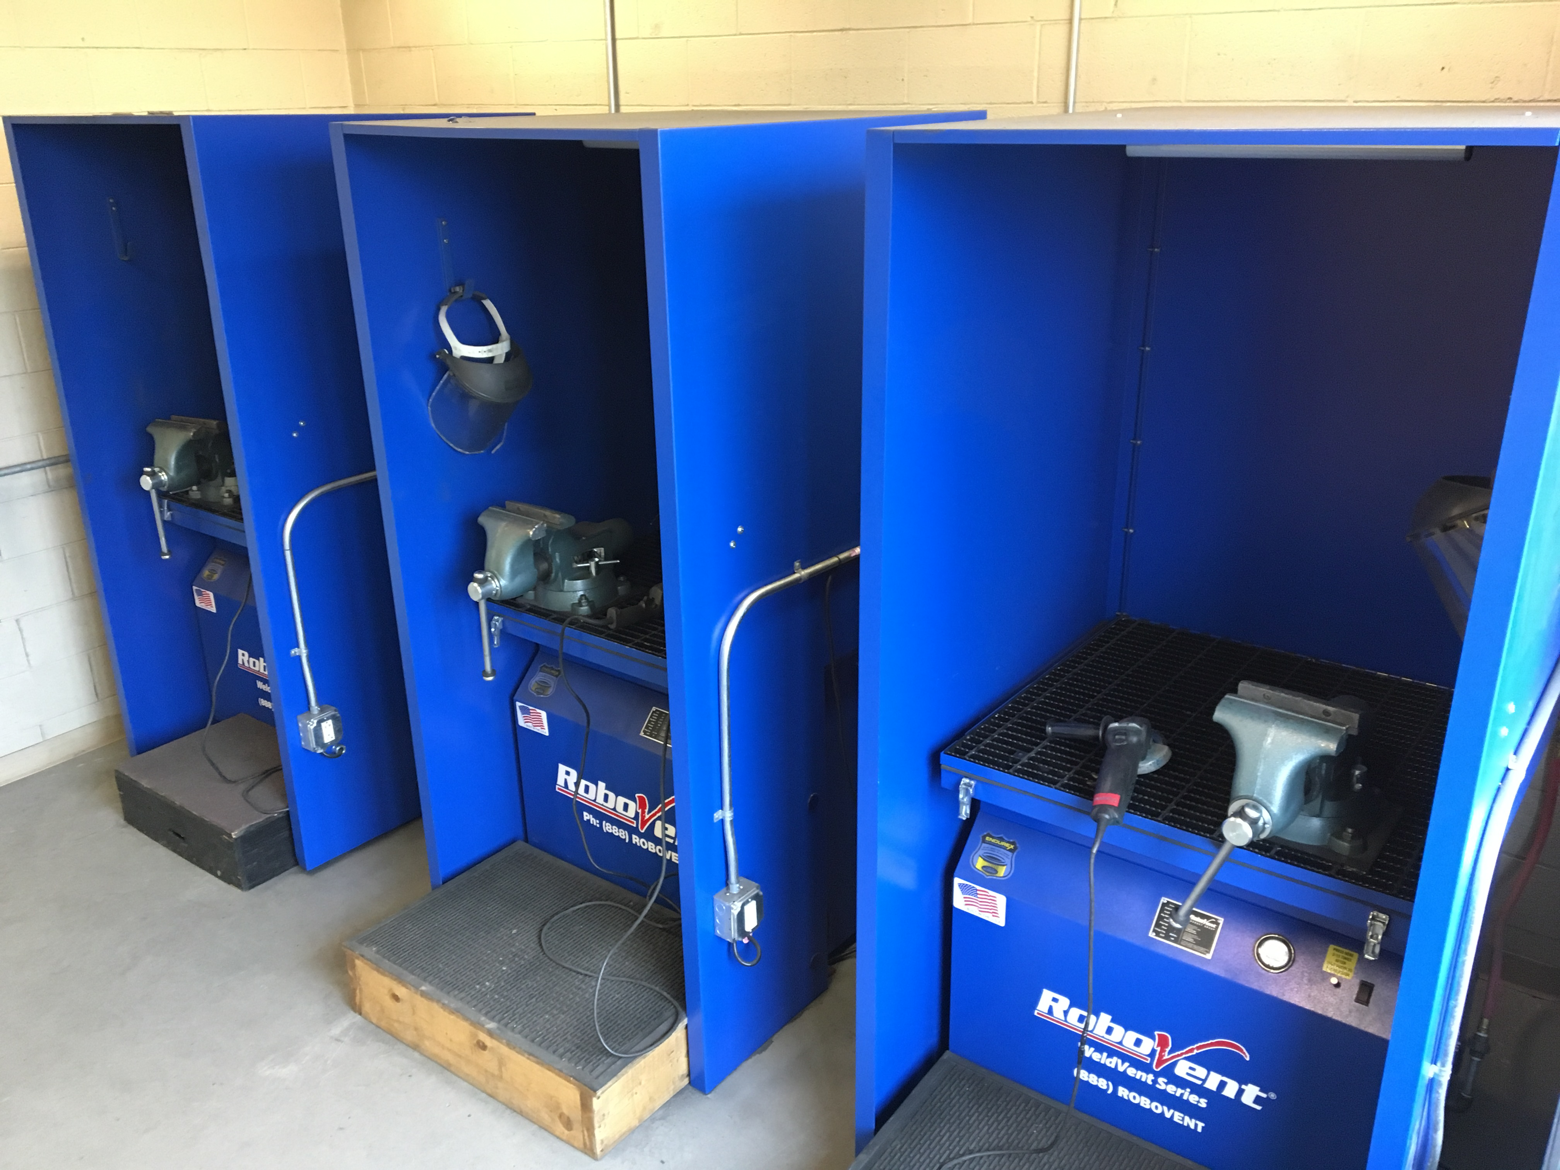
Equipment

Slide 26
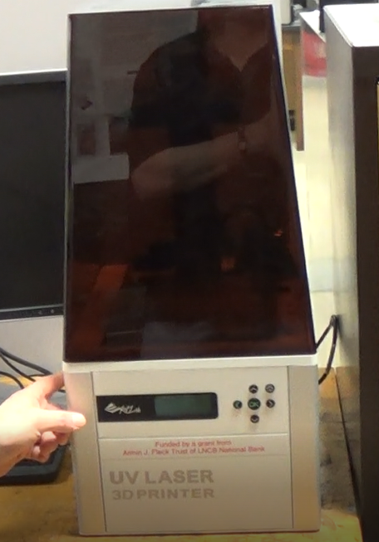
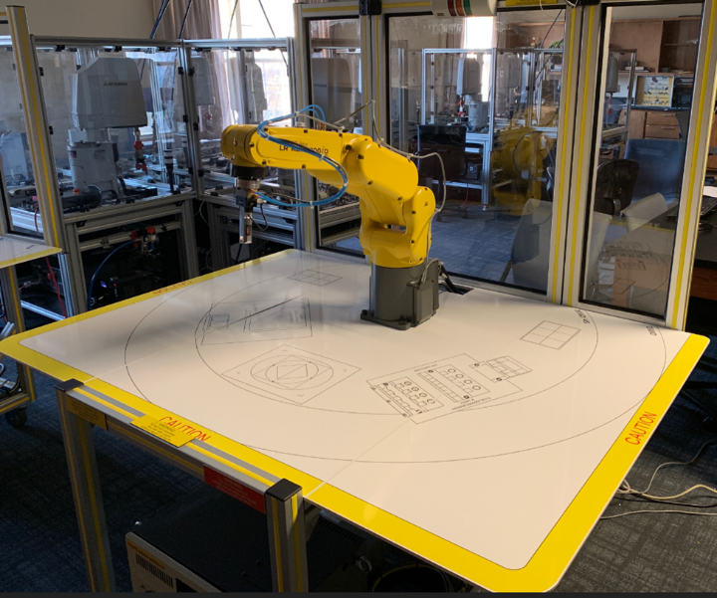
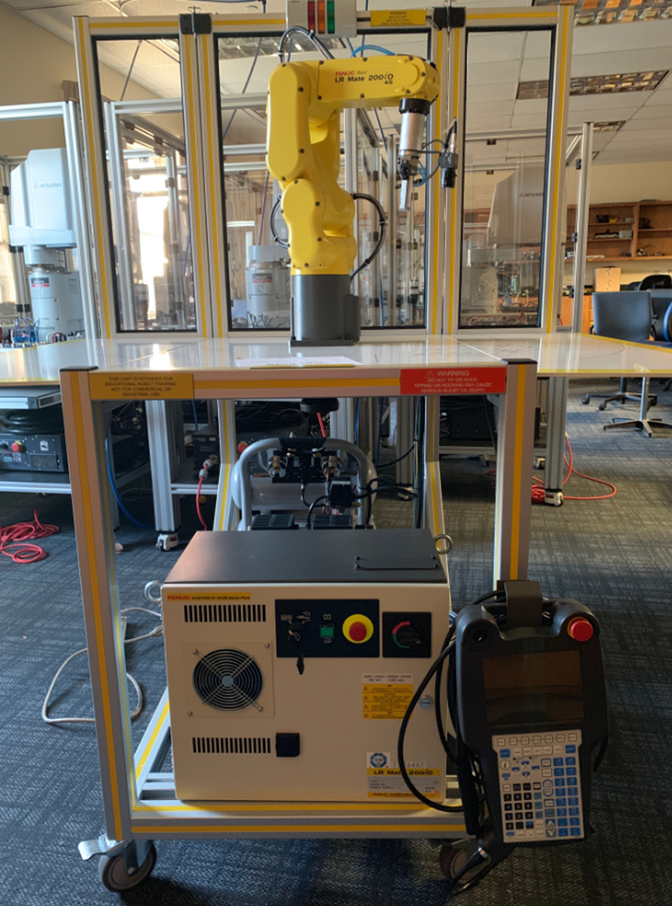
Equipment

Slide 27
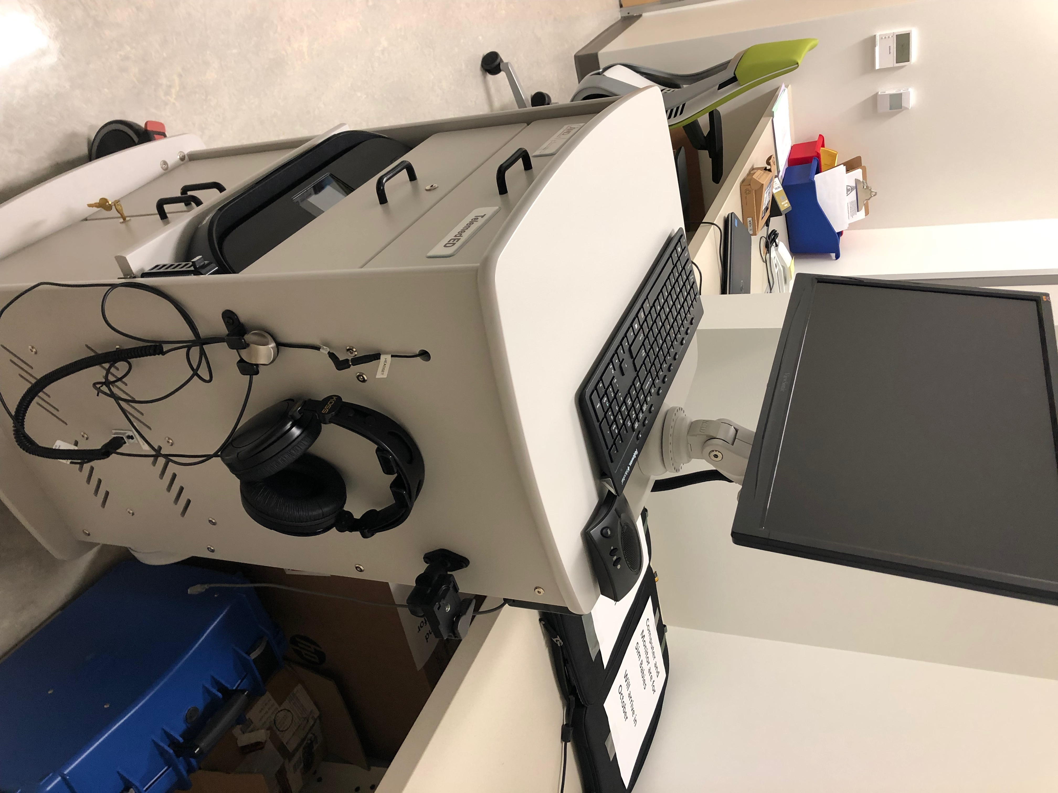
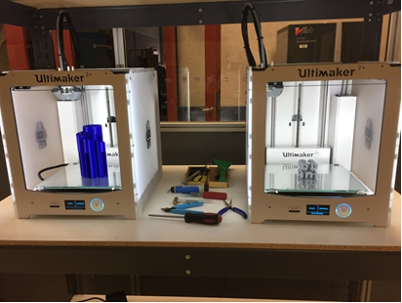
Equipment

Slide 28
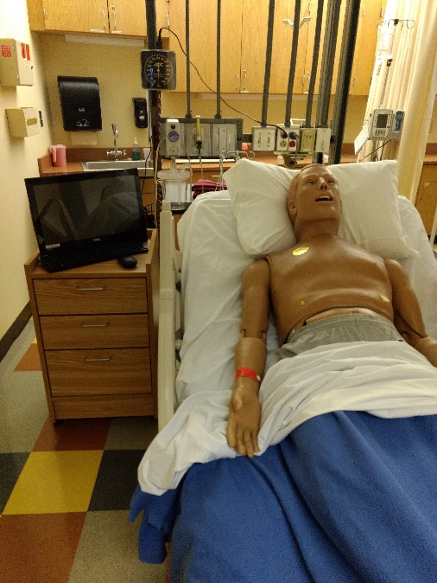
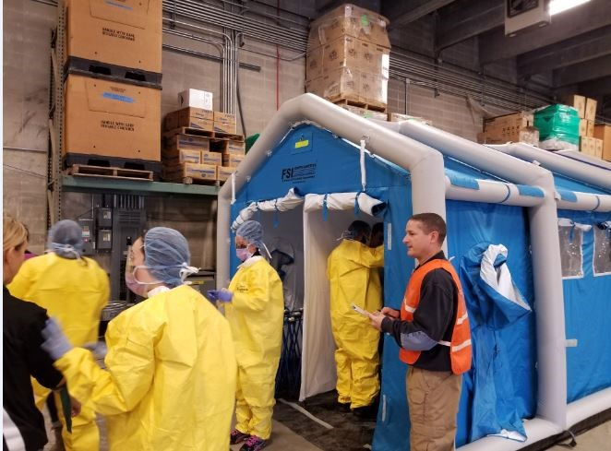
Equipment

Slide 29
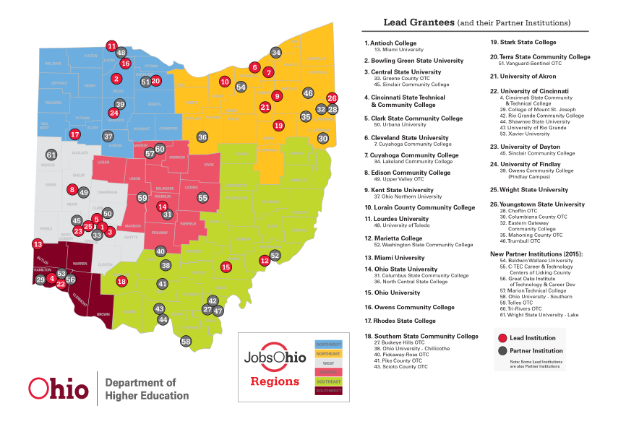

Slide 30
OMIC – Funded Activities
Regional marketing
Engagement with College Credit Plus students
Local partnerships with small-medium sized companies
Support for student travel and housing
Internship preparation courses developed with business
Business subsidies on sliding scale

Slide 31
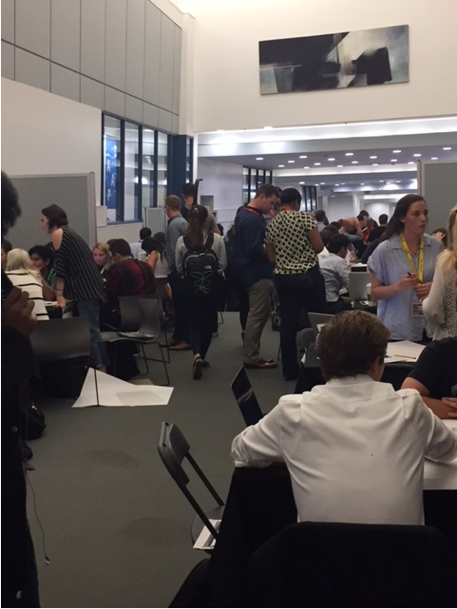
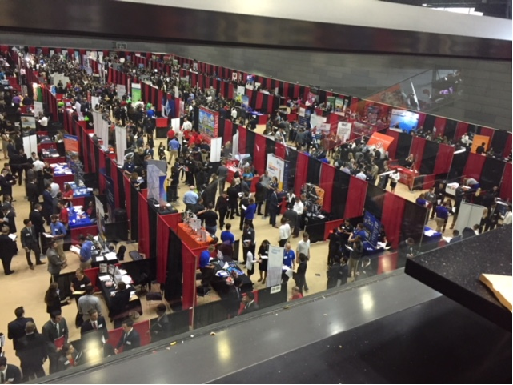
Student Engagement and Career Fairs

Slide 32
Top Industries
Industry | Percent Participation
Manufacturing | 42%
Professional and Technical Services | 14%
Other Services | 8%
Finance and Insurance | 6%
Retail Trade | 5%
Information | 5%
Construction | 3%

Slide 33

Apprenticeships
Cooperation with the Apprenticeship Ohio
  Registered Apprenticeships
Pilot program with Community Colleges
Exploring opportunities to expand with Ohio Technical Centers

Slide 34
Manufacturing
Increase the pipeline of talent
  Improve and deepen skills
  Identify new skills
Technet
  23 community colleges
  5 universities
  Ohio Manufacturers Association
Review of the place of industry certificates
Foundational courses
Image and marketing

Slide 35

Advanced Technology- IT
Cyber Security – OC3
  Education sub committee
  List of programs
Business partners
  Producers of technology
  Consumers of technology
Developed cyber-range

Slide 36


Construction
Strong and growing business demand
Coordination with technical centers and community colleges
Promote certificates and credentials
Image and marketing

Slide 37
Career Development/Student Success
Developed best practices
Academic and career advising
Career services
  Partnerships with industry
Student engagement
  Connection to the institution
  Entry pathways and services
  Progression – focusing on the finish
  Completion and opportunities for the future

Slide 38
THANK YOU
Cheri Rice, Ph.D.
Associate Vice Chancellor Higher Education Workforce Alignment
614-728-3092
crice@highered.ohio.gov
John Magill
Assistant Deputy Chancellor, Economic Advancement
614-752-9530
jmagill@highered.ohio.gov

